Slide 1
Welcome to Year 5! Together we will make it a success!

Slide 2

Meet the team
Mr Ford
Mrs Burrows
Mrs Trude
Mrs Taylor
Mr Jones Teaches PE lessons on a Tuesday afternoon
Mr Proctor teaches music
Miss Wright will teach PSHE and RE every other Thursday

Slide 3
Timetable
8.40 – 8.55 Register/morning activities
9.05 – 9.20 Assembly
9.20 – 10.30 Maths
10.30 – 10.45 Break
10.45 – 12.15 English
12.15 – 13.00 Lunch
13.00 – 13.20 Additional maths and Accelerated Reader
13.20 – 14.10 Lesson 3
14.10 - 15.10 Lesson 4
15.15 – 15.20 Story/reflection time
Additional activities:
Drumming Mr Proctor
Music curriculum Mr Proctor
Interventions in maths, reading, comprehension, spelling, handwriting, times tables, SPaG, nurture etc
PE this term is Monday and Tuesdays. Look out for the occasional bonus PE day.

Slide 4
Topics/Events
Autumn term – The Tudors, visit to Ford Green Hall Year 5 and 6 Winter warmer in the hall, disco Wednesday 8th October fireworks night Friday 7th November
Spring term – The Victorians – visit to Quarry Bank Mill on Thursday 5th February, Year 5 Victorians assembly Thursday 12th February, disco February 11th
Summer term – India, Worm Charming is Saturday 13th June,

Slide 5
Accelerated Reader
Half termly star reader tests
How can we track children’s progress? Quizzes Once children have completed their book, they will take a short online quiz. This will test their understanding of the book. They will score points if they pass the test and their word count will be recorded within their personal login page on the AR website. Y3 and 4 children have a flower picture that they aim to complete and Y5/6 have a bar chart to show their progress.
Can my child still choose any book? Yes of course! We would never discourage a child from reading. Children can have a ‘Free Choice Book’ in addition to their Accelerated Reader Book. This can be any level, fiction or non-fiction. Children can of course complete quizzes on these books too.

Slide 6
Accelerated Reader
AR at home. Children can login to their AR account at home, from there, you can see what books they have been reading and how they have performed in their latest quizzes. If you want to check the Accelerated Reader level of a book you have at home/want to buy, you can visit ARBookFind.co.uk
Rewards: Certificate in assembly and a Gold Medal Award for completing their flower/bar chart. Children’s photographs will be placed on the Millionaire Reader Display – library. Certificates and prizes will be awarded when children have read 250,000,500,000,750,000 and 1 million words.
Please let me know if you ever struggle to access AR at home. The children have their own login which is the same as last year.

Slide 7
Times tables and Sumdog and homework
We will continue to teach and access the children on their times tables
We will continue to use Sumdog this year to support the children’s maths skills in a fun way both in school and at home
Homework will be set on Seesaw on Tuesday evenings or Wednesday mornings and will alternate between maths and SPaG skills
Please try and listen to your child read at least 3 times per week
Please encourage your child to complete AR quizzes at home

Slide 8
Writing, reading and spelling in school
Children will receive 2 spelling lessons per week
3 Guided Reading sessions per week
5 P&G starter lessons per week
4 writing lessons per week
Additional reading, writing and SPaG interventions as well as maths interventions throughout the year for all attainment levels

Slide 9
Internet safety and mobile phones
Know what your child is doing- watch and consider if the content appropriate?
Be interested!
Check accounts/channels and know their passwords
Check usernames and contacts
Limit time on devices
Ban usage near bedtimes and keep devices out of the bedroom
Concerns ? Talk to child/ school/ other parents/ police
Most of all BE OPEN and TALK….
Recommendations within schools suggest delaying getting your child a mobile phone as long as possible. It remains the cause of the majority of issues in Year 5 and 6.
Show additional PP regarding the above.

Slide 10
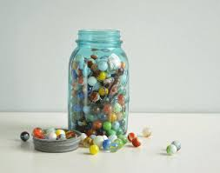



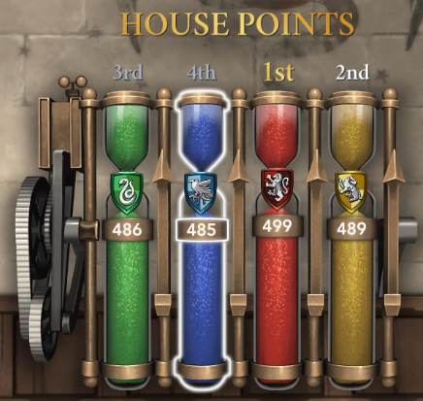

Behaviour policy
Same as last year.
2 Stars of the week certificates given out in Celebration assembly.
1 Brill kid certificate given out per term nominated by class peers
Head teacher award given out in end of term assembly nominated by class and head teacher.

Slide 11
Parent Handbook
We have been asked to remind you to read the parent handbook and observe any changes inside
Main points are around encouraging the children to take pride in themselves, their work and the school. PE kits, school uniform, no make up etc
The school gates will be open from 8.40am and the classroom doors from 8.45am.
The gates will stay open until 8.55am, therefore any children arriving after this time will need to be brought to the school office and will be marked as late on the register.
Children are asked to remove or tape over earrings on PE days and we ask that children with shoulder length hair or longer, tie this back on PE days, and please don’t wear makeup.
Please be aware that children must wear their school PE kit NOT football tops/sports tops etc. unless it is a non-uniform day.

Slide 12
Ideally, we don’t allow children in Year 5 to bring mobile phones into school. This generally happens in Year 6 due to children walking home by themselves. However, if your child does ever bring a mobile phone into school for a particular reason, then we please ask that they hand it in to Mrs Bottomley in the office before entering school, and then collect it at the end of the school day once they have been dismissed.
Other parents should not take a child home unless school has been informed.
During the summer term, I will invite all parents into school to join in with a lesson with the children. We will also once again invite parents in for a lesson during science week.

Slide 13
If you ever want to speak to me
Please feel free to share a quick message with me in the playground before school.
For issues regarding a longer discussion, please arrange an appointment to see me/telephone appointment after school with the office.

Slide 14
How can you help at home…..
Weekly homework tasks
Times tables
Reading – Hearing your child read, asking questions about the text, encouraging reading different types of texts – comics, information books etc.
Handwriting – encourage your child to join their writing at home and take pride in their presentation of work
Discuss the term’s topic, look up information, visit the library

Slide 15
Any questions?

