Slide 1

WELCOME TO YEAR THREE

Slide 2
Meet the staff:
Mrs Craven & Mrs Windsor – Class Teachers
Miss Bradley, Mrs Gidman and Mrs Hargreaves– Teaching Assistants
Mr Jones – PE coach

Slide 3
Important times of the Day
8.40
Gate opens
8.45
Door opens
8.55
Gates & doors close
10.30
Morning Break
12.15 - 1.00
Lunchtime – varies across the week
3.20
Home time/After-school club

Slide 4
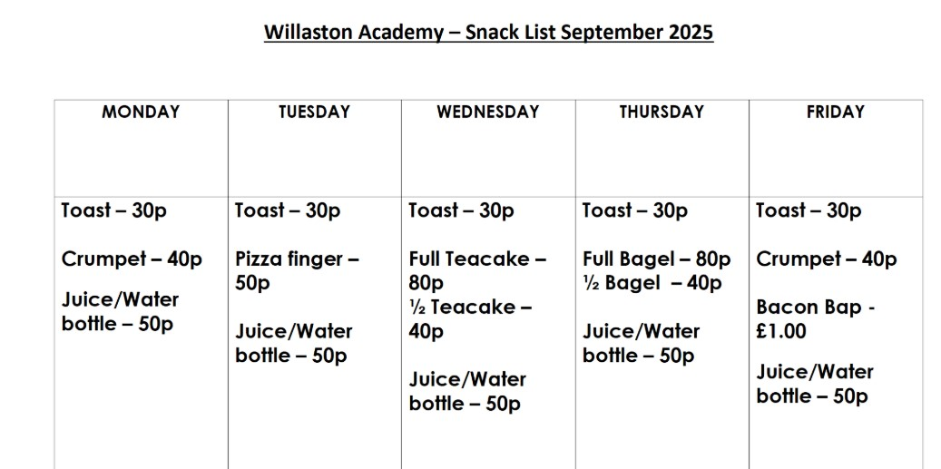
Snack

Slide 5
Topics
Autumn 1 – Stone Age
Autumn 2 – Cities and counties of the UK
Spring 1 – Bronze Age/Iron Age
Spring 2 – Europe – France and Spain
Summer 1 – The Ancient Greeks
Summer 2 – Willaston and Nantwich

Slide 6
Reading
Children should read at least 3 times a week at home – please record in the Reading Record
Children will be heard reading by us during our phonics sessions
As a school we are happy for children to read their own books in addition to school books.
Book List for Year Three.
Reading for Pleasure Comics

Slide 7
Homework
As well as reading at least 3 times a week, the children will receive a homework task via Seesaw on Fridays, to be completed by the following Friday, this will be an alternate Maths/English task
We also ask that times tables facts for x2, x3, x5, 10 are practised as often as possible.
Sumdog is an interactive online learning platform to be used at home and in school.
BBC Supermovers is a great resource to help children learn their times tables whilst keeping active!

Slide 8
P.E.
Tuesday morning – Led by Mr Jones/Mrs Craven
Friday afternoon – Led by Mrs Windsor
Children will come to school on the above days in their PE kit/for the whole day.
PE days may change or added during the year but we will let you know if this happens
Please ensure your child has their hair tied back or a bobble with them on these days and earrings are removed.

Slide 9
Communication
Please contact us via the school office – the office staff will pass on any messages; we will get back to you as soon as possible by telephone or email
Medicines (prescribed) to be handed to office staff with a completed medication form
Lip balm and throat sweets to be kept on the desk of the teacher
Please can you ensure your contact details are up to date to allow us to contact you easily
Check the Class Page on the Website to see what Year 3 have been doing
Any additional messages may be given out on Seesaw or with a note home.

Slide 10
Visits/Special Events
:
Day visits/special visitors/workshops to be arranged throughout the year:
Visit to Liverpool in Autumn 2
Parent drop-in lesson TBC
Christmas Church Service – Friday 12th December
Visit to Ironworks – Spring Term

Slide 11
What you can help with at home…
Times tables – x2, x3, x5, x10, x 3, x4, x8
Spellings – Year 2 Spelling Lists and weekly spelling focus
Reading – Hearing your child read, asking questions about the text, encouraging reading different types of texts – comics, information books, newspapers etc.
Handwriting – encourage your child to form their letters correctly at home and take pride in their presentation of work
Discuss the term’s topic; look up information, visit the library
Using dictionaries, thesauruses, atlases at home

Slide 12

Any Questions...
Thank you for coming!
Word and book lists.

