Slide 1


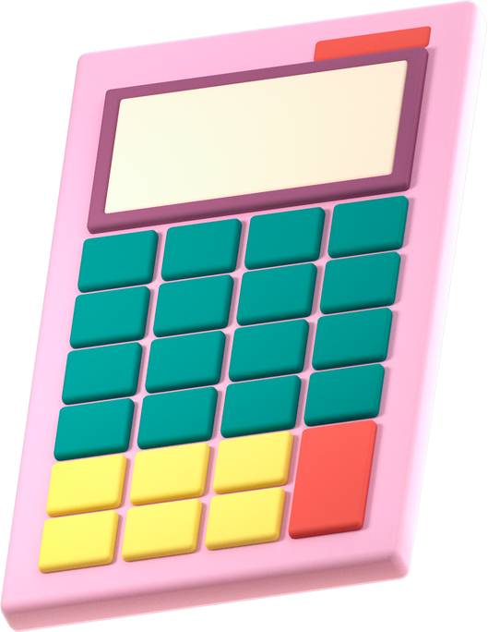





Meet the teacher

Slide 2
Our Year 2 Team
  Mr Woollam
  Mrs Wallace
  Mrs Hargreaves
  Mrs Taylor

Slide 3
Y2 Timetable
  Classroom doors open at 8:45 and close at 8:55
  School gates will shut at 8:55
  Our school day ends at 3:20

Slide 4
School Uniform
Winter time:
  Grey trousers/grey skirt/pinafore dress/culottes
  White or navy polo shirt
  Navy cardigan/sweatshirt (Logo versions are available, but not essential)
  Navy/Grey tights
  Black shoes*
Summer time:
  Blue and white gingham dress
  White or navy polo shirt
  Grey tailored shorts/culottes
  Sun hat/cap
  Black shoes*

Slide 5
PE Days
  Our PE days are on a Thursday and a Friday
  Throughout the year, we will also have some extra PE slots on a Wednesday - you will be informed of these on Seesaw.
PE Kit
PE kits must follow our uniform policy:
  Navy bottoms
  T-shirt in the house colour (the school logo is not essential)
  PE indoor pumps or appropriate trainers
  Navy fleece / jumper
  If your child has earrings, please ensure that they’re either taped up or taken out on PE days and long hair is tied back.
  If your child attends an afterschool sports club, they must wear our PE uniform

Slide 6
School Uniform
  No smart watches (Fitbits and step trackers are fine, but no smart watches than can receive calls or take pictures)
  No jewellery - necklaces, bracelets, rings etc.
  No makeup

Slide 7
What does my child need?
  A small bag (to put letters and a book in)
  Their lunch (if they bring one)
  Water bottles
  If they have a club with Mr Jones then they can bring their PE kit in their bag
  Please make sure that any items brought in are clearly labelled
  Belongings will be kept in their lockers

Slide 8

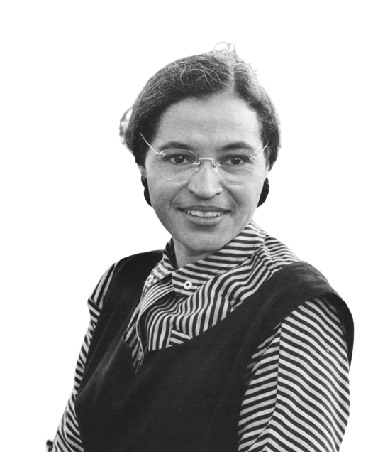

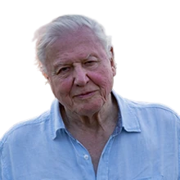
House Points

Slide 9

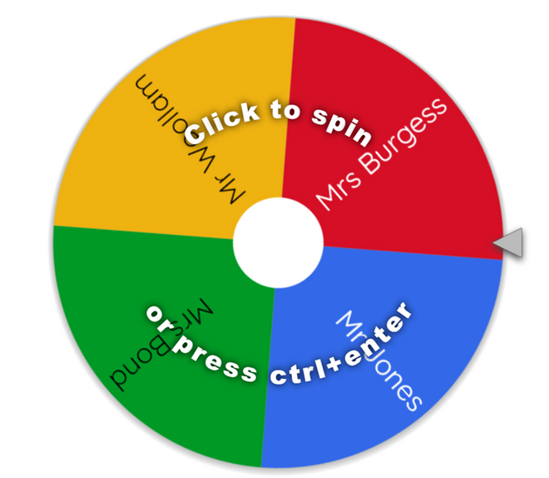
Silver Medallists:
  5 house points
  Name on the wheel
Gold medallists:
  10 house points
  Name on wheel
  Email home on Friday

Slide 10
Marbles
  Whole class goal - all working together to achieve a marble
  Amazing class behaviour around school / in class earns a marble
  Once the class earn 50 marbles, they earn a reward afternoon
  The class choose their reward (once achieved I will send a message out)

Slide 11
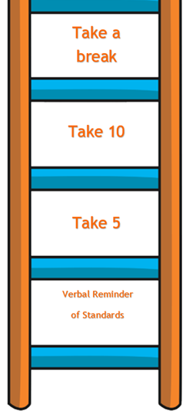
Low Level Unacceptable Behaviour
  Loitering
  Low level disruption in class
  Failure to complete classwork
  Rudeness
  Incomplete homework
  Use of mobiles on school grounds
  Graffiti or defacing school property

Slide 12
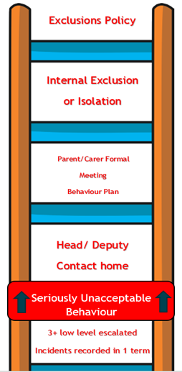
Serious Unacceptable Behaviour
  Discrimination
  Harassment
  Bullying
  Cyberbullying
  Theft
  Verbal Abuse
  Aggressive behaviour
  Homophobic, Biphobic and Transphobic discrimination

Slide 13
Accelerated Reader
  Accelerated reader is how we monitor the progress and comprehension ability of our children in their reading
  It allows for children to read a variety of books and challenge themselves simultaneously
  The class completed their AR assessment in July and we will re-assess them in October

Slide 14
Accelerated Reader
  Once a child has finished a book, they can do a quiz (at home or school)
  The quiz tests how well they’ve understood what they’ve read and will give them a score
  We recommend that the class are reading at least 4 times a week at home

Slide 15
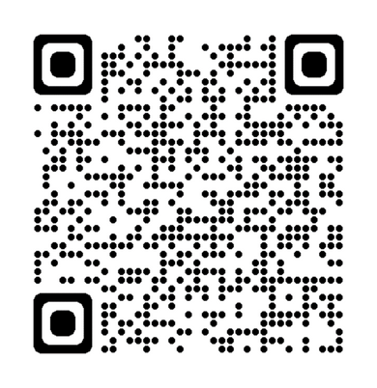
Accelerated Reader
  This QR code will take you to the login page ( I have a paper copy for you to take home too)
  The user name is the first letter of their first name followed by the first 4 letters of their surname. For example: JBLOG (capitals do not matter)
  Their password is ABC
  If they have an older sibling with the same initials, they will need a 1 after their user name e.g James Blog would be jblog1

Slide 16
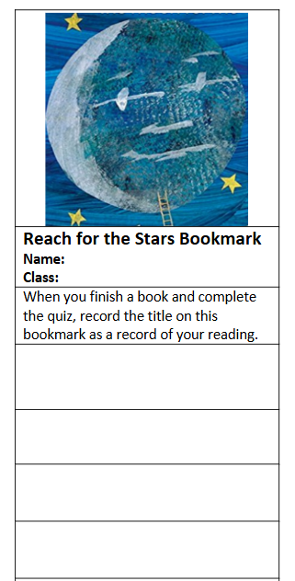
Accelerated Reader
  Your child will have a book mark as well as a reading record
  The bookmark has their reading level on it and their reading record is to be filled in when your child has been read with

Slide 17
Reading Records
  Your child has been sent home with a reading record. These are to be filled in by parents and staff to monitor how regularly each child is being read with.
  We will also put in any AR quiz scores they complete in school - so that parents at home can see how successfully their child is quizzing.

Slide 18
Reading Records
  Your child has been sent home with a reading record. These are to be filled in by parents and staff to monitor how regularly each child is being read with.
  We will also put in any AR quiz scores they complete in school - so that parents at home can see how successfully their child is quizzing.

Slide 19
Reading For Pleasure Bags
  Every Friday, we will give out our reading for pleasure bags to different members of the class
  We will need these back in school the following Friday

Slide 20
Seesaw and Homework
Seesaw is my way of sending home announcements and reminders. It is also how I will be setting homework.
If you need to contact me, please use the school office or catch me on the door, not through Seesaw.
Homework this year will be either English or maths, depending on the week as they’ll alternate.
The maths will be on Sumdog - new to the class
The English could be a range of things - set on seesaw
I will also set specific times tables practice on Sumdog each week. We highly recommend practicing these.

Slide 21
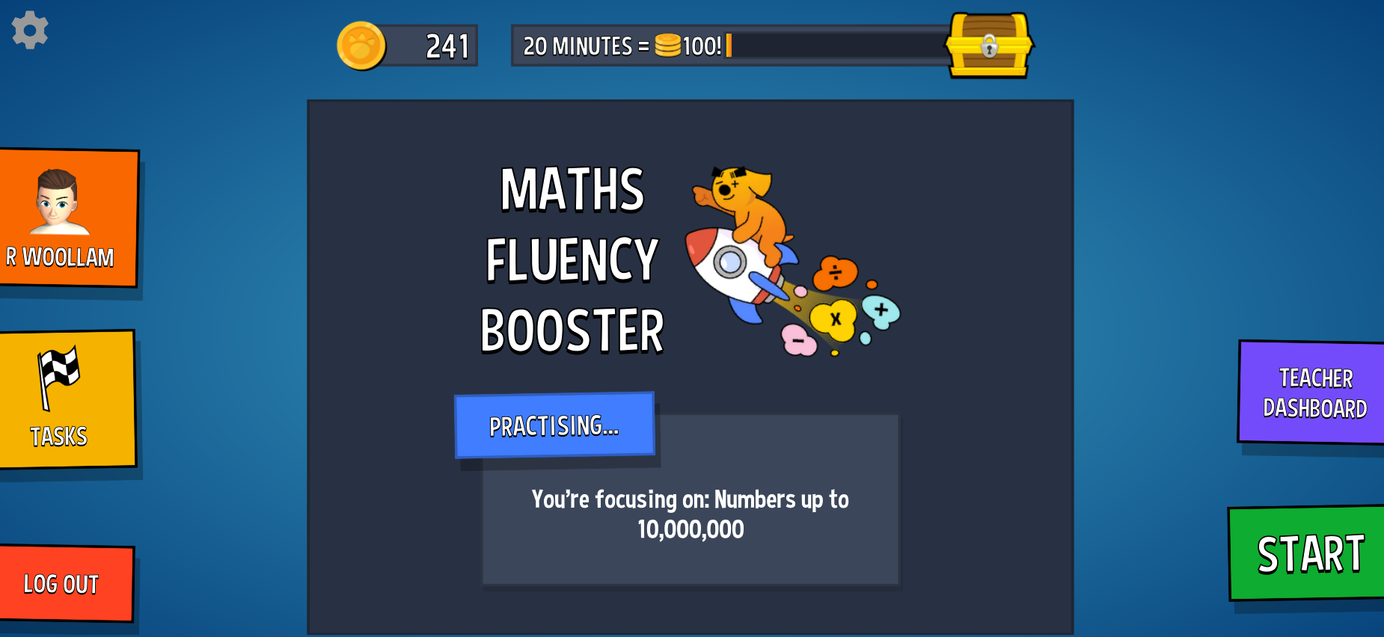
Homework tasks will be found in the task section

Slide 22
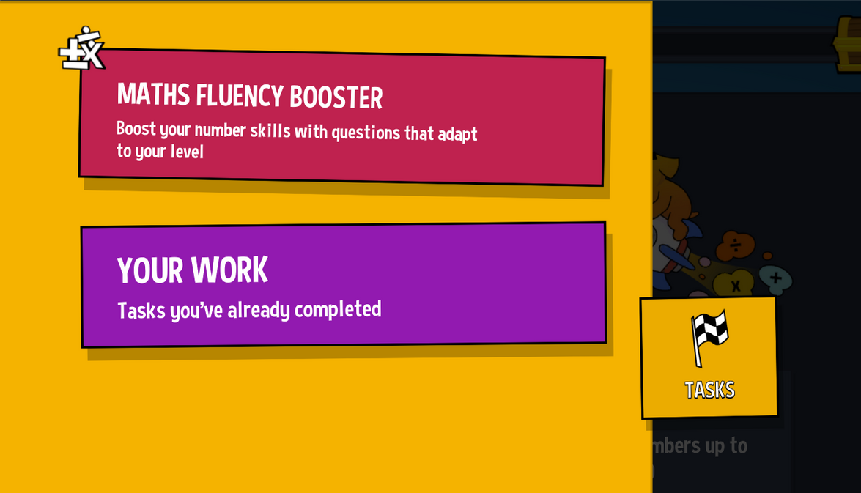
Times tables homework will also be set at your child’s level.
We aim for children to leave year 2 knowing their 2s, 5s and 10s securely (any more is a bonus!)

Slide 23
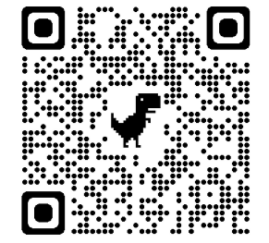
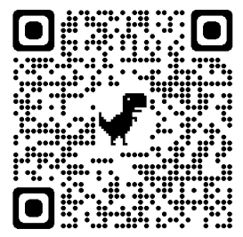
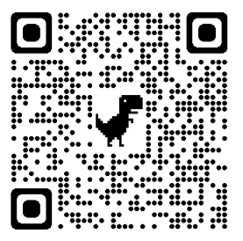
Times Tables
BBC Supermovers
Times table games
Hit the button

Slide 24






Our Topics
Autumn
Spring
Summer
1
2

Slide 25
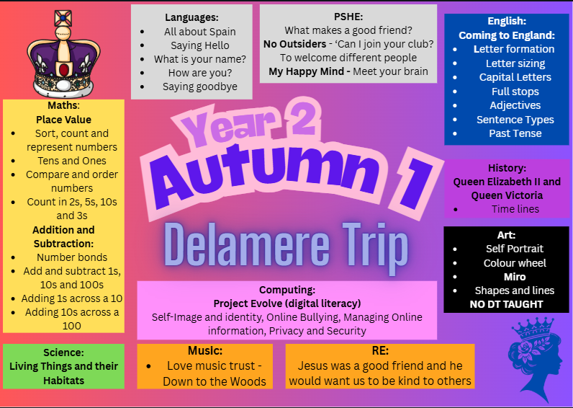

Slide 26
Key Events:
  Delamere Trip - 26th September
  Christmas Show:
9th December (PM)
10th December (AM)
  Egyptian visitor - Tuesday 13th January 2026
  Australia Assembly - March 20th 2026 (AM)
  Castle school trip - date TBC

Slide 27
Key Events:
  Sports day - TBC
  Y2 SATS - May
  During the Spring term, we will hold a meeting to discuss the procedures and provide more information about our SATS

Slide 28
How to help at home
  Timestables – x2, x5, x10​
  Spellings – Year 2 Spelling Lists and weekly spelling focus
​
  Reading – Listen to your child read, ask questions about the text, encourage reading different types of texts – comics, information books, newspapers etc.​
  Handwriting – encourage your child to form their letters correctly at home and take pride in their presentation of work​
  Discuss the term’s topic; look up information, visit the library​
  Using dictionaries, thesauruses, atlases at home

Slide 29
Messages from the Office
Anyone who arrive after 8:55 will be marked as late on the register
If you have permission to park on the school car park, please do not park in front of the double gates to the playground
If you need to use the breakfast club, please ensure that you book as we may have to turn you away due to numbers / ratios
The same applies to after school club
You can book this on the Gateway system
If your child is ill, please let the office know

