Slide 1
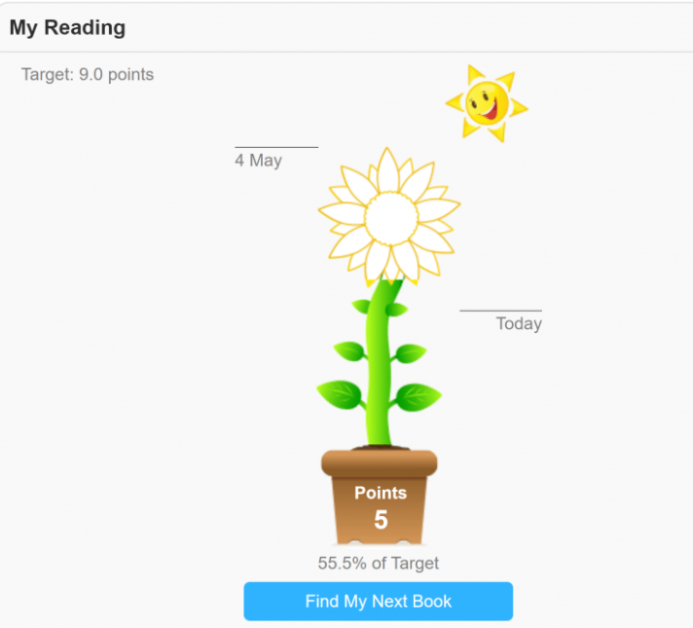
Accelerated Reader
Why use Accelerated Reader?
Accelerated Reader is a new KS2 approach to reading in school. It is designed to encourage children to love reading, to read more and to read books which are at the correct level to improve their reading ability.
How do we decide what level books children need to read?
Children will complete termly online ‘Star Reader’ tests to determine their reading level. Books in school have been levelled and labelled with a decimal number from 0-6. Once they complete the test, children will be told what level of book they should be reading – their ZPD score. Their score will be a range of numbers, for example 2.5-3.1. They can choose any book within that range as their ‘Accelerated Reader Book.’ this book will help them to progress.
How can we track children’s progress? Quizzes
Once children have completed their book, they will take a short online quiz. This will test their understanding of the book. They will score points if they pass the test and their word count will be recorded within their personal login page on the AR website.
Y3 and 4 children have a flower picture that they aim to complete and Y5/6 have a bar chart to show their progress.

Slide 2

Accelerated Reader
Can my child still choose any book?
Yes of course! We would never discourage a child from reading. Children can have a ‘Free Choice Book’ in addition to their Accelerated Reader Book. This can be any level, fiction or non-fiction. Children can of course complete quizzes on these books too.
In Class
5x weekly 30 minute sessions. Quiet reading time. A focus on Reading for Pleasure in every class.
AR at home.
Children can login to their AR account at home, from there, you can see what books they have been reading and how they have performed in their latest quizzes.
If you want to check the Accelerated Reader level of a book you have at home/want to buy, you can visit
ARBookFind.co.uk
Rewards:
Certificate in assembly and a Gold Medal Award for completing their flower/bar chart.
Children’s photographs will be placed on the Millionaire Reader Display – library. Certificates and prizes will be awarded when children have read 250,000,500,000,750,000 and 1 million words.
This is a new scheme for staff, it will take a little time to get the children set up on the system. However, once we are on a roll we can decide if any new books are required to top up existing supplies. Please do let the class teacher or Mrs Patrick know if you have any questions.

Slide 3

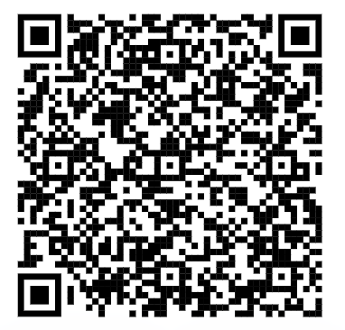
Accelerated Reader Access for Children
Children have been given unique logins and passwords by the class teacher. They can login at the address above.
QR – direct website login. Please feel free to photograph this and save to your phone! I will send a paper copy home with this printed on to stick on the fridge!

